Slide 1
Searching for A Living Place for a Student in Boston
Usama Bin Shakeel
IBM Data Science Professional certificate

Slide 2
Why we should do it?
Boston is home to a large number of students. These students face problem in finding a suitable neighborhood to live in.
The neighborhood should contain all facilities which are necessary for a common residential neighborhood so that students could access all these facilities within their walking distance
Through our project, we will find a suitable neighborhood for these students.

Slide 3
Dataset
The dataset was obtained from https://data.boston.gov/dataset/boston-neighborhoods .
The dataset was further wrangled to remove certain columns and rows.
The longitudes and latitudes were further added to the dataset.
The latitudes and longitudes were searched on google and added to the data frame manually.

Slide 4
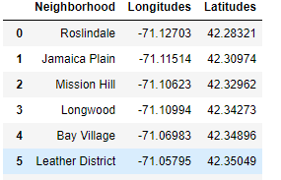
Final Dataset Head

Slide 5
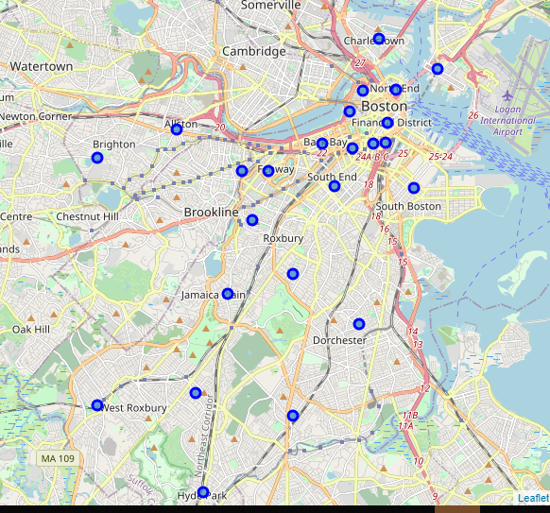
Map of Neighborhoods of Boston

Slide 6
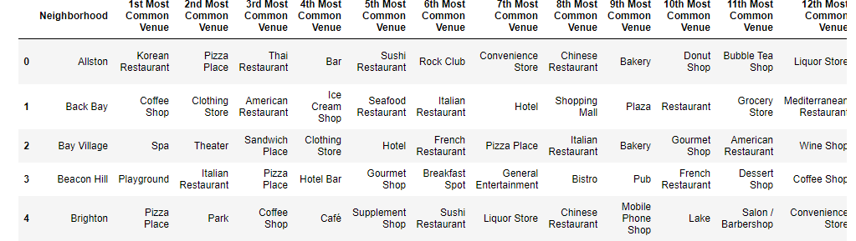
Most Common Venues in Neighborhoods

Slide 7
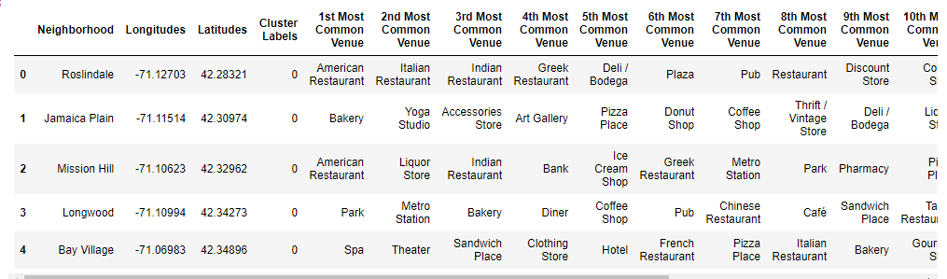
Clustered Neighborhood Dataset Head

Slide 8
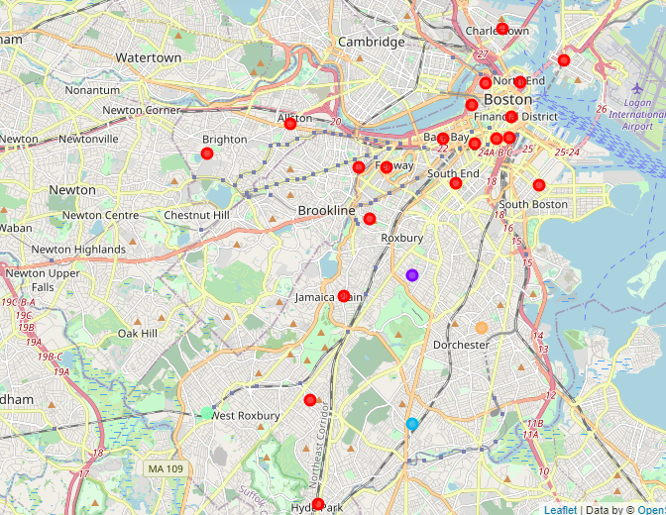
Clusters on Map

Slide 9
Conclusion and Recommendations
If we closely observe the neighborhoods in all the five clusters, we can see that the most suitable neighborhood for a student to reside in is West Roxbury. It lies in cluster 4. This neighborhood as all the necessary facilities which a residential neighborhood should have in walking distance such as bank, gym, train station, pharmacy etc. All the other neighborhoods in other clusters seem more to have a saturation of restaurants. So, it is recommended based on the results that a student should search for a living place in West Roxbury.

